Slide 1
ICT PERSONAL PORTFOLIO
Presented by:
Muhammad Ibraheem Noor
21F-9068
BSCS (1A)

Slide 2
IDEA/REASON
Reason:
Less time consuming
Can be used in future
Telling people about me
Showcasing my skills and projects
Idea:
Used cognitive mind
Aesthetic look
Enlisting my chief information

Slide 3
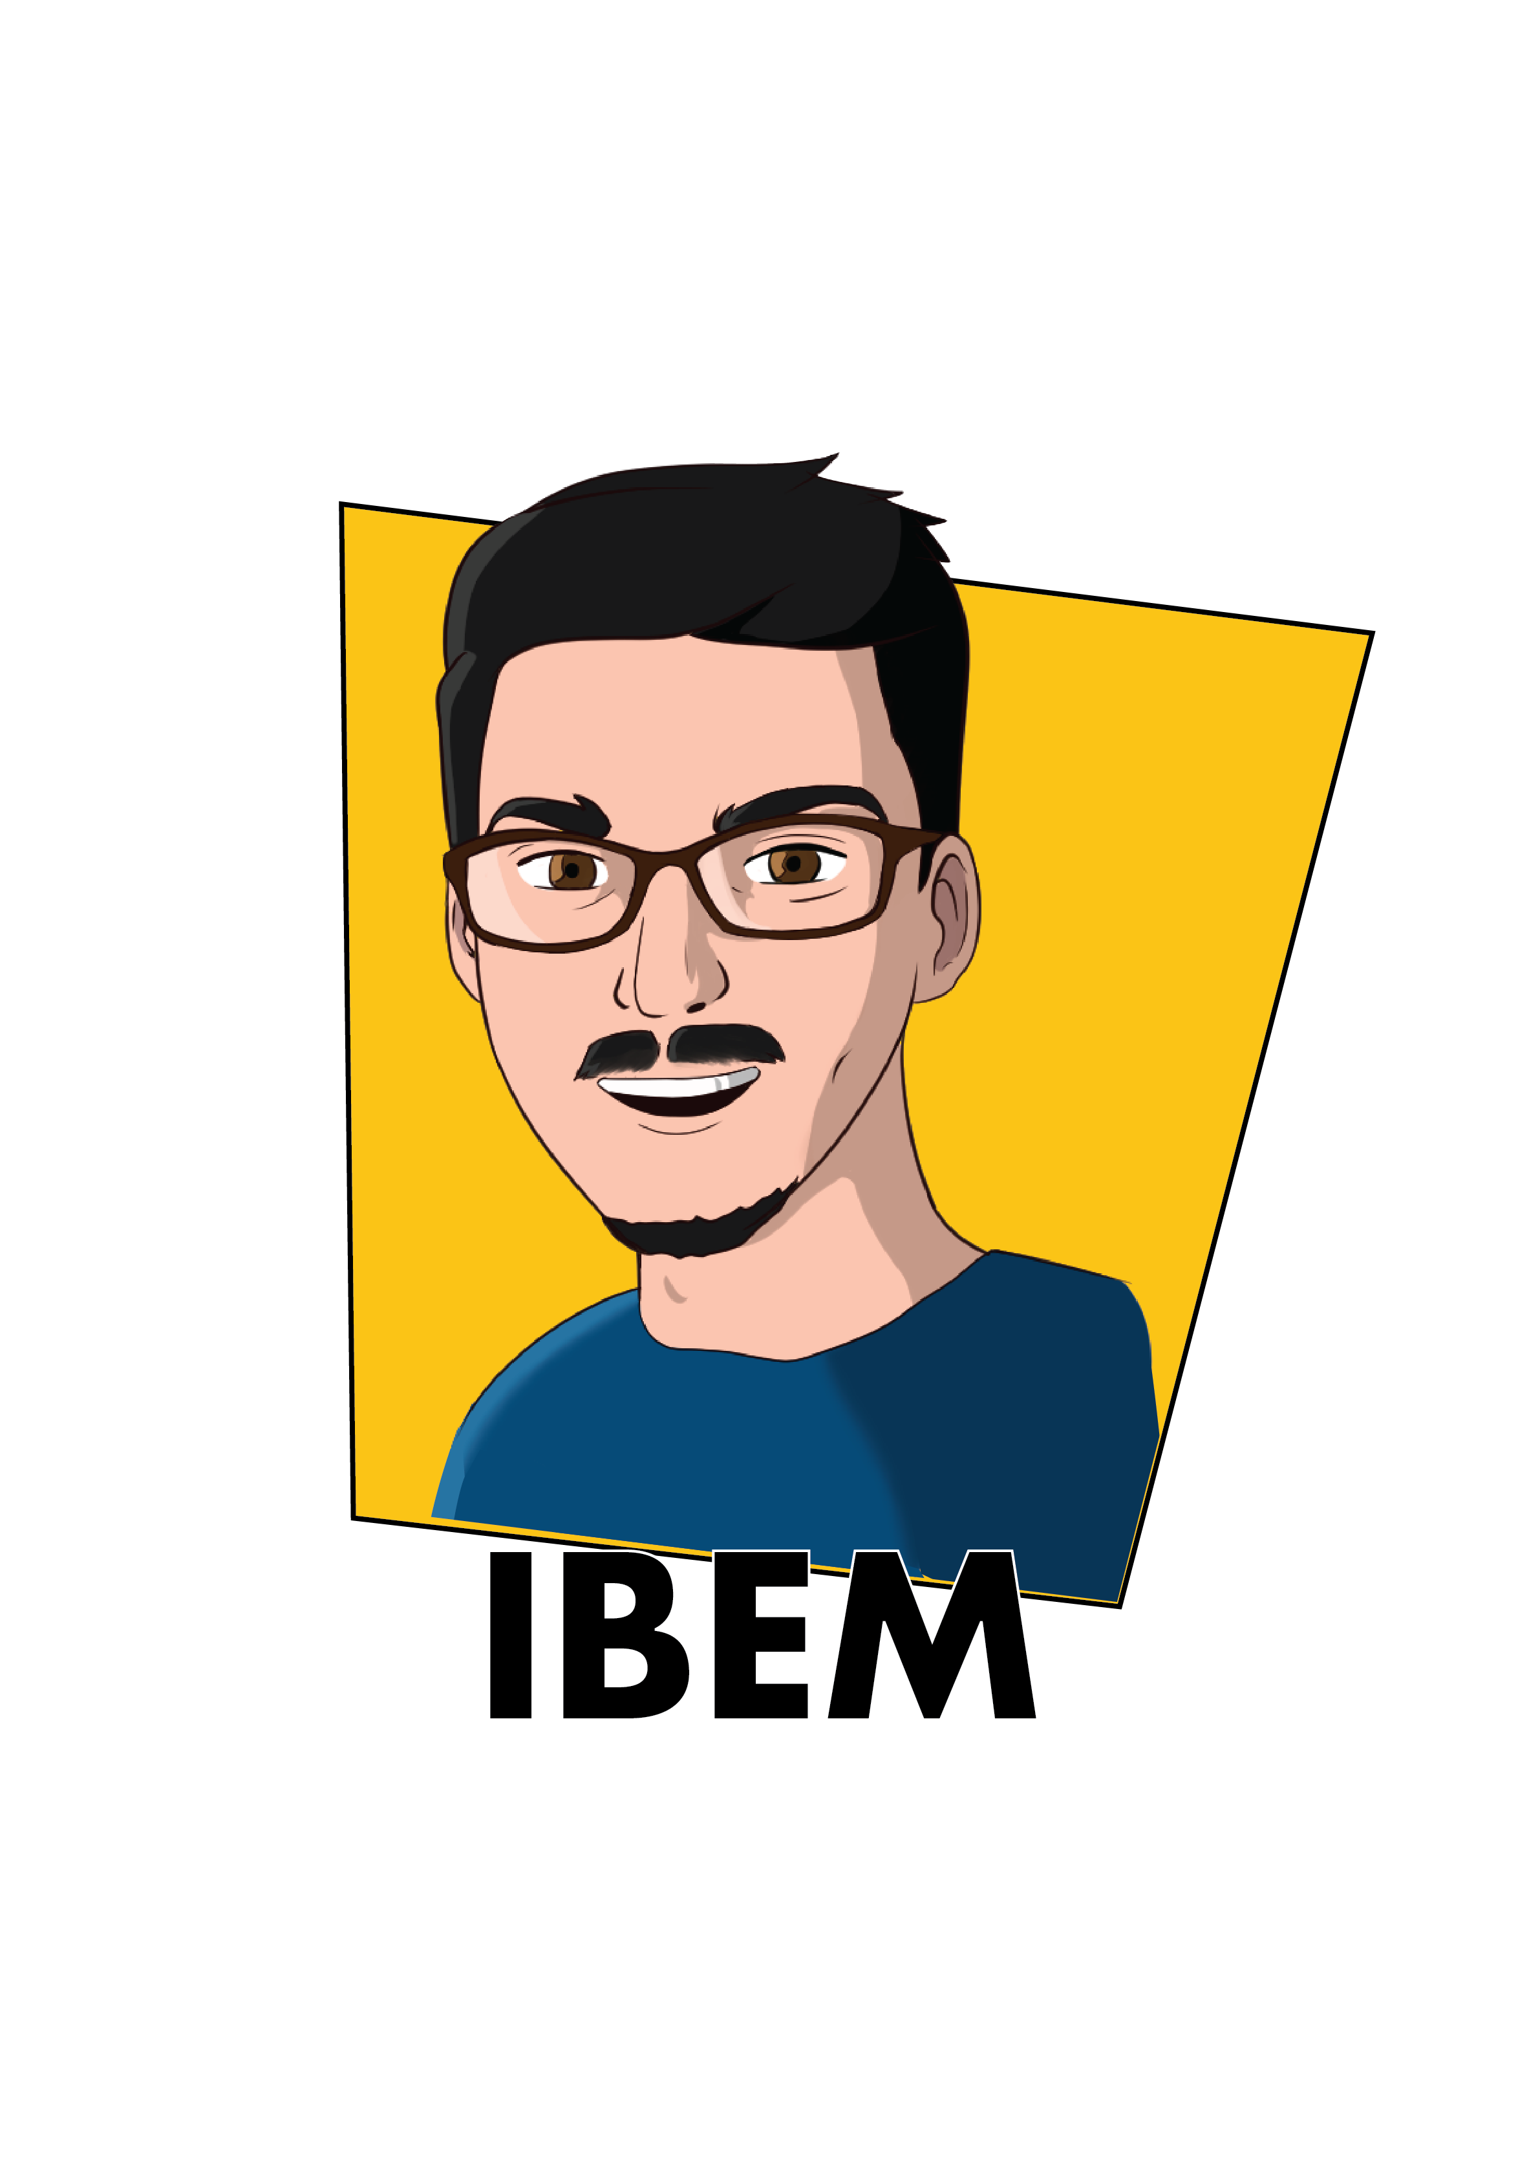
TOOLS USED
For LOGO:
Adobe Illustrator
For Web development:
Sublime Text 3
Technology:
HTML
CSS

Slide 4
DESCRIPTION
My learning source for HTML and CSS was a YouTube channel “Free Code Camp (Mike Dane)” and website “w3schools.com”. My illustration teacher is “GFX Mentor”.
I decided the design and theme for my portfolio and used Illustrator and Sublime software applications. I did my 100% work on my own.
This portfolio depicts my personal information, goals and enthusiasm for my field. It is a prototype of my skills and projects.

Slide 5
THANK YOU!

